Slide 1
Beyond the Bento Box
Using linked data and smart algorithms
to integrate discovery beyond search results
Mark Noble and Jordan Fields | Marmot Library Network

Slide 2
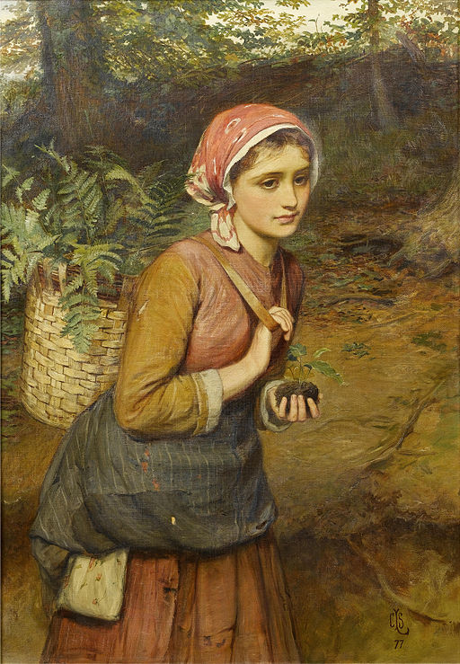
A quick review
https://commons.wikimedia.org/wiki/File:Charles_Sillem_Lidderdale_The_fern_gatherer_1877.jpg

Slide 3
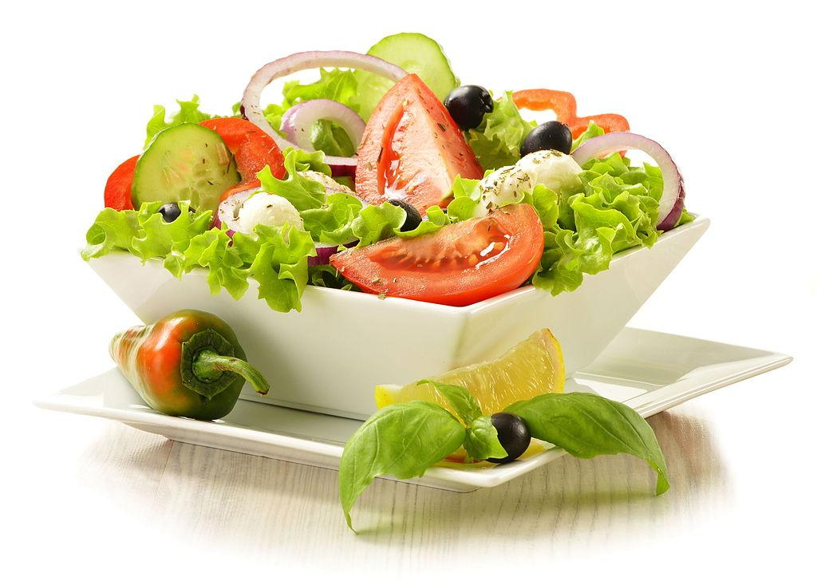
A quick review
https://commons.wikimedia.org/wiki/File:Saladlt95.jpg
https://commons.wikimedia.org/wiki/File:Charles_Sillem_Lidderdale_The_fern_gatherer_1877.jpg

Slide 4
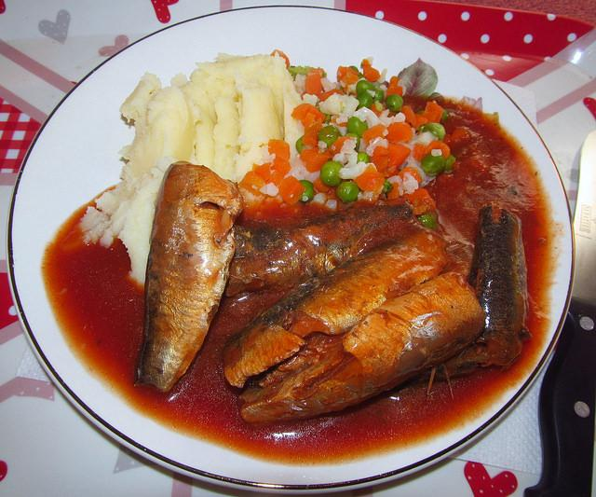
A quick review
https://commons.wikimedia.org/wiki/File:Saladlt95.jpg
https://commons.wikimedia.org/wiki/File:Charles_Sillem_Lidderdale_The_fern_gatherer_1877.jpg
https://www.flickr.com/photos/zongo/17380133979

Slide 5
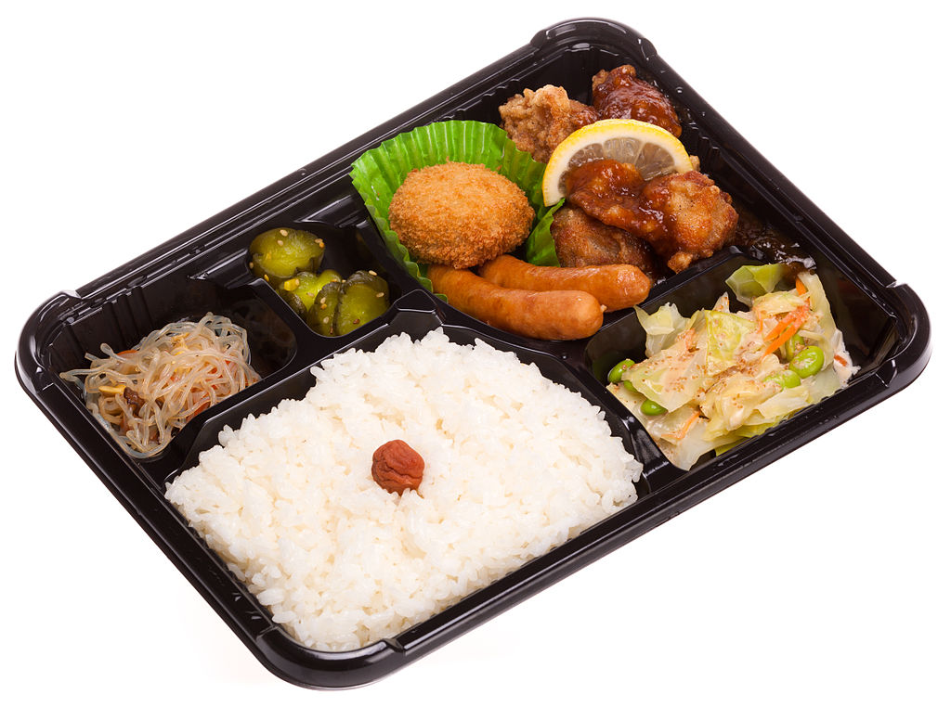
A quick review
https://commons.wikimedia.org/wiki/File:Saladlt95.jpg
https://commons.wikimedia.org/wiki/File:Shop-made_bento_box.jpeg
https://commons.wikimedia.org/wiki/File:Charles_Sillem_Lidderdale_The_fern_gatherer_1877.jpg
https://www.flickr.com/photos/zongo/17380133979

Slide 6
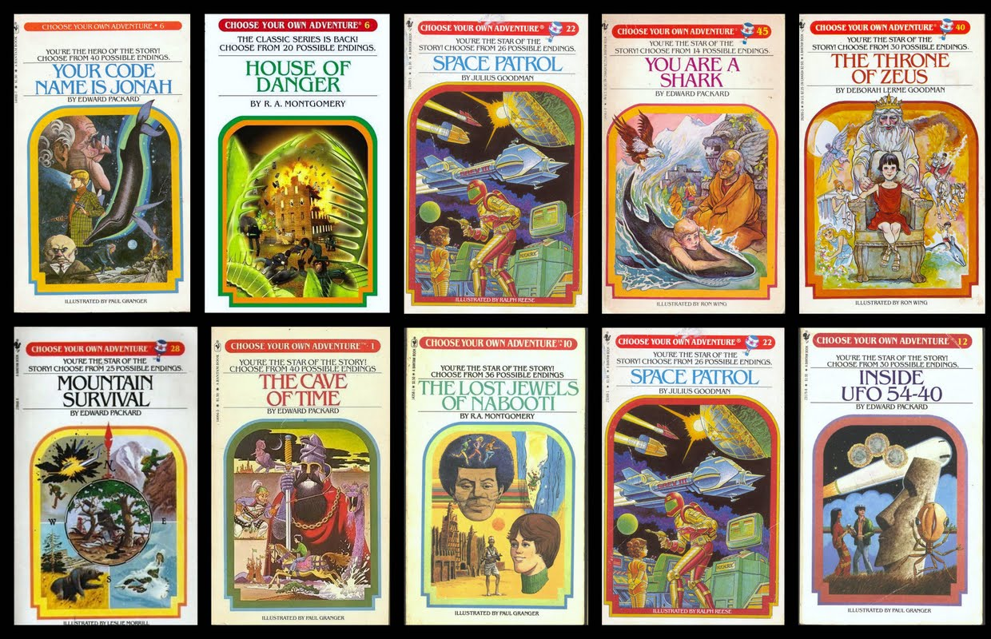
CHOOSE YOUR OWN ADVENTURE!!!!!
http://www.liketotally80s.com/2013/06/choose-your-own-adventure-books/

Slide 7

A bit about us
nonprofit / library technology / consortium
6 discovery partners
3 public libraries (CO, VA, NC)
2 consortiums (CO)
1 public/school partnership (TN)
27 consortium members
16 public libraries
6 academic libraries
5 school libraries
all Colorado

Slide 8
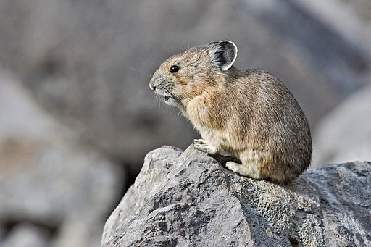


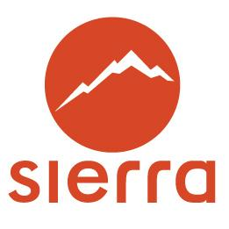



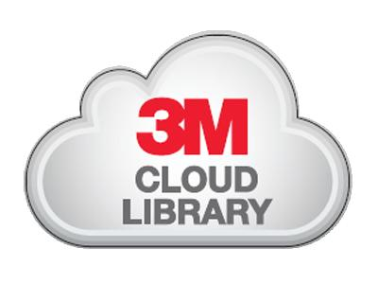
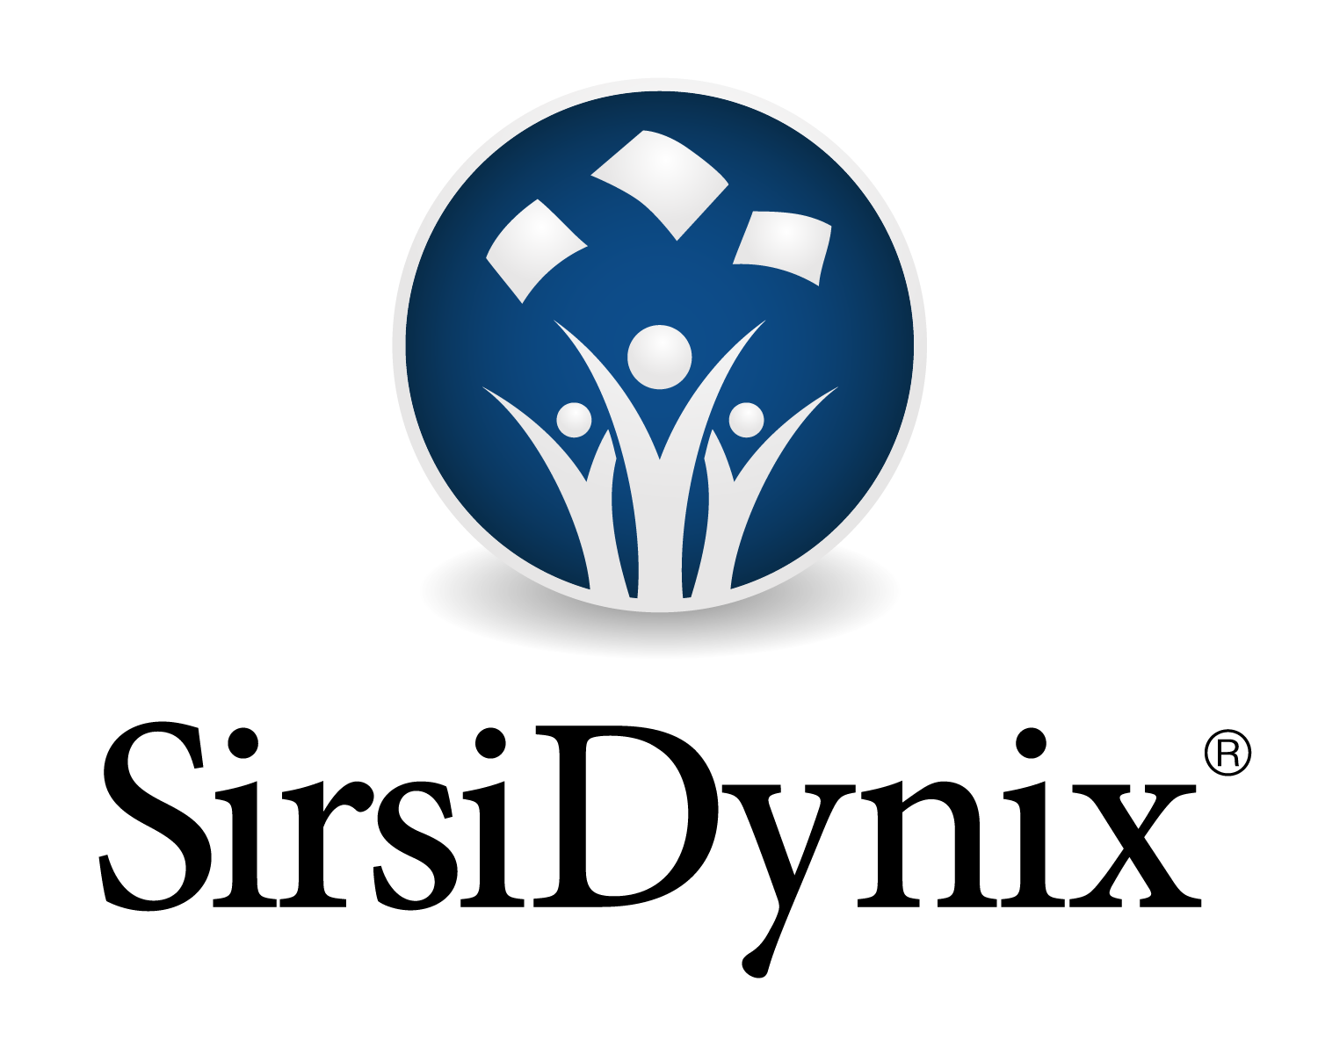




A bit about us
many thanks to
PIKA
https://commons.wikimedia.org/wiki/File:Pika.jpg

Slide 9
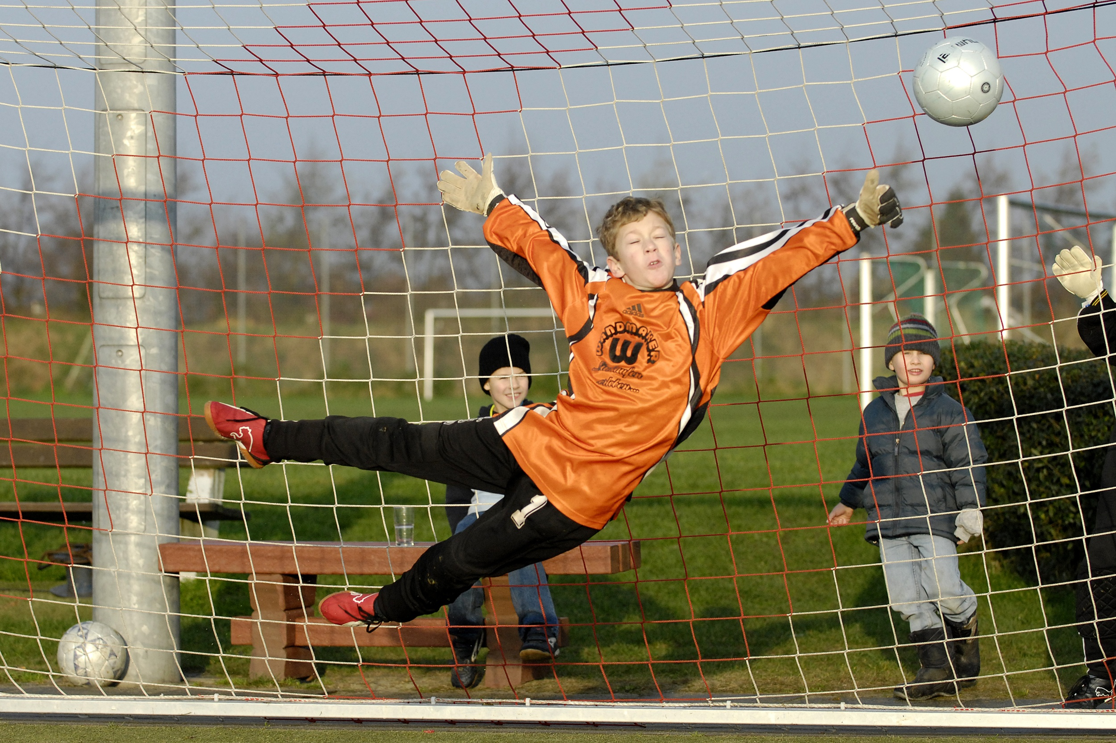
Goal
At every step in the research process the user is presented with relevant suggestions from across all library resources.
https://commons.wikimedia.org/wiki/File:Soccer_Youth_Goal_Keeper.jpg

Slide 10

Caveats
still alpha
placeholder icons
more css work
more usability
algorithm refinements

Slide 11
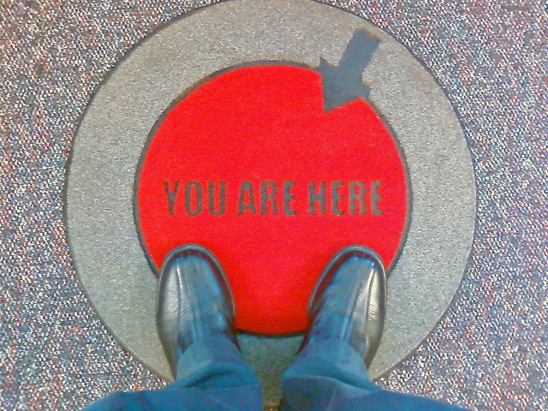
A quick tour
https://www.flickr.com/photos/joelogon/4613630072

Slide 12
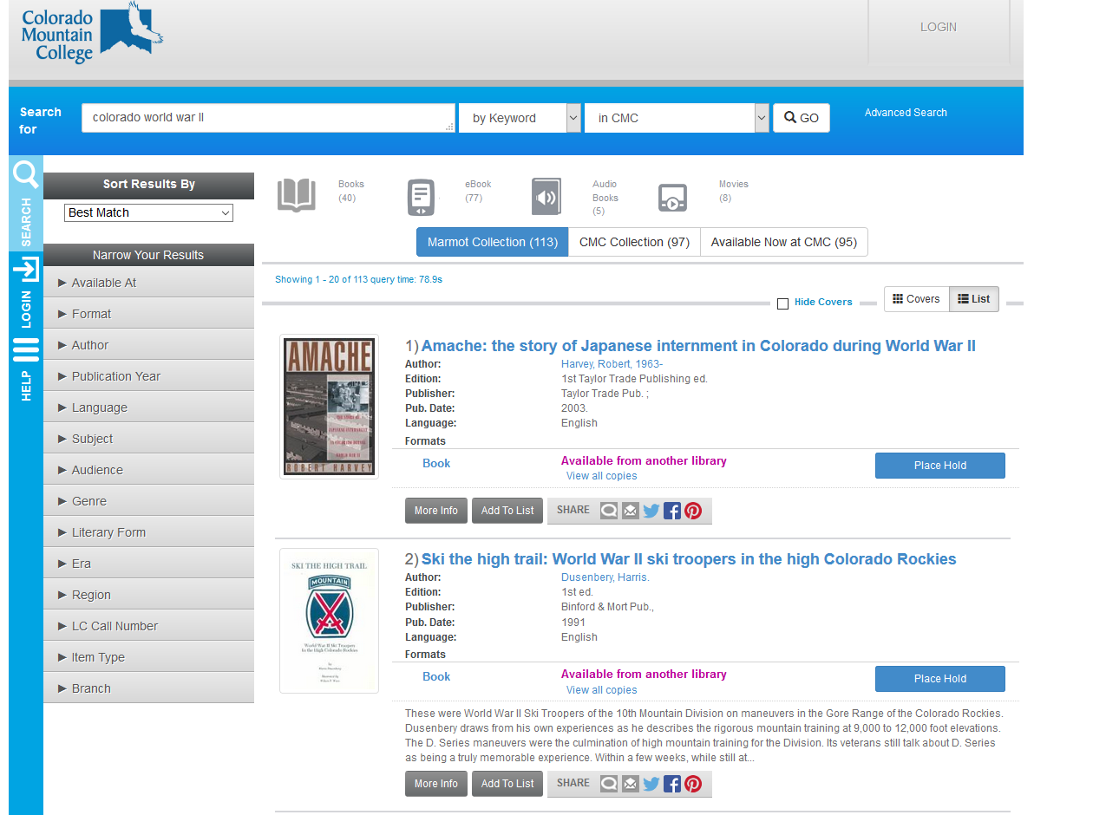

Slide 13
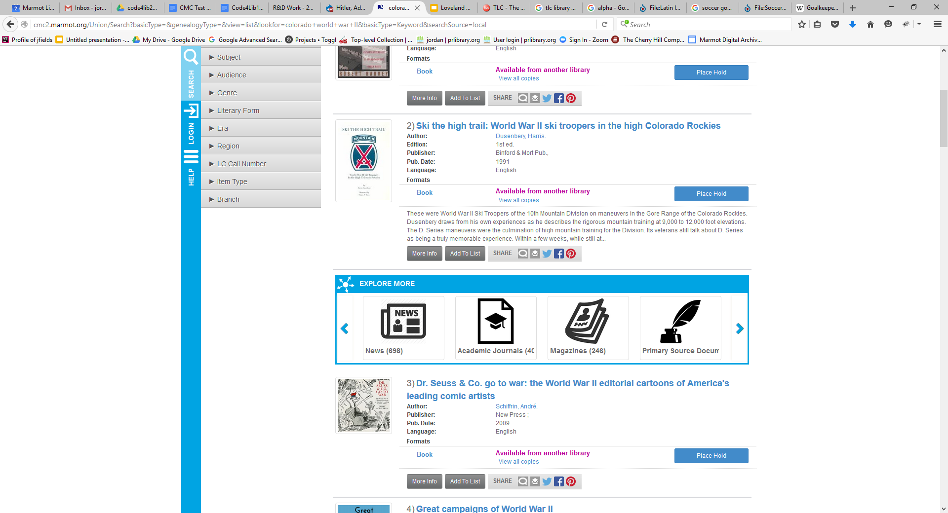

Slide 14
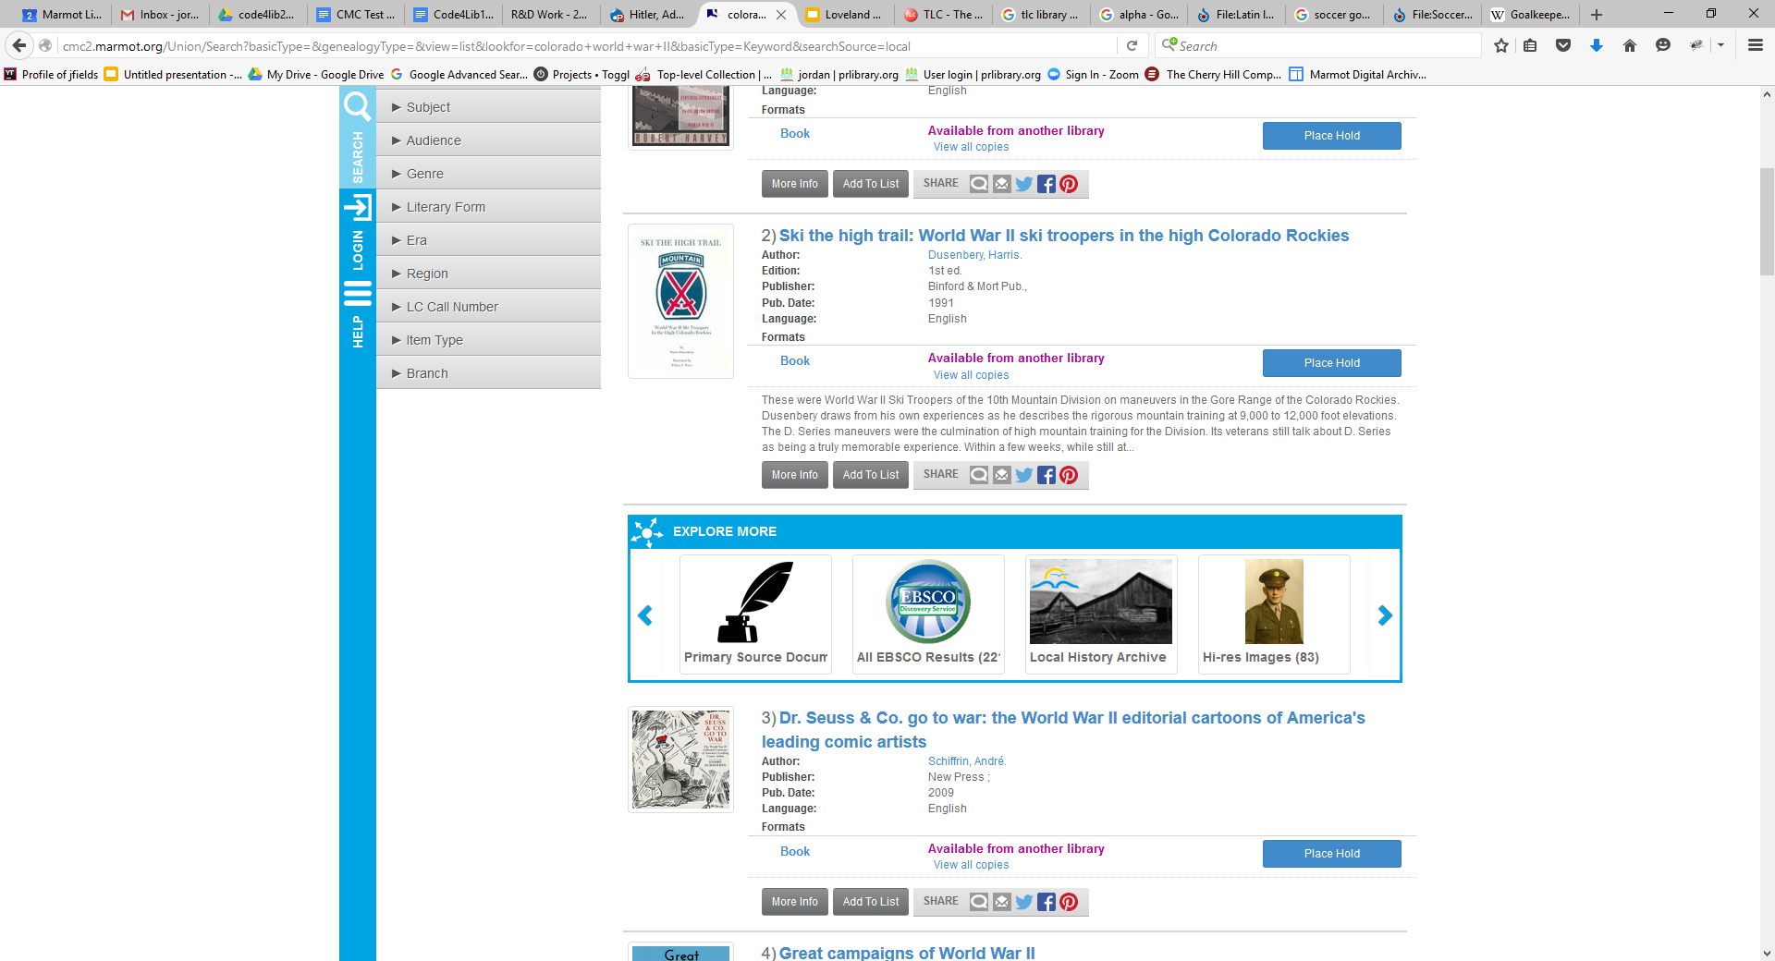
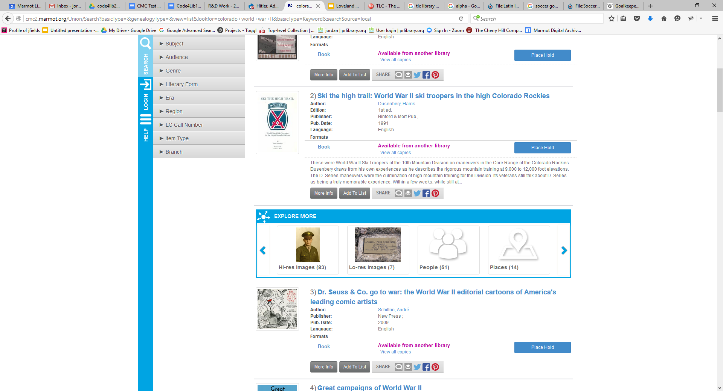

Slide 15
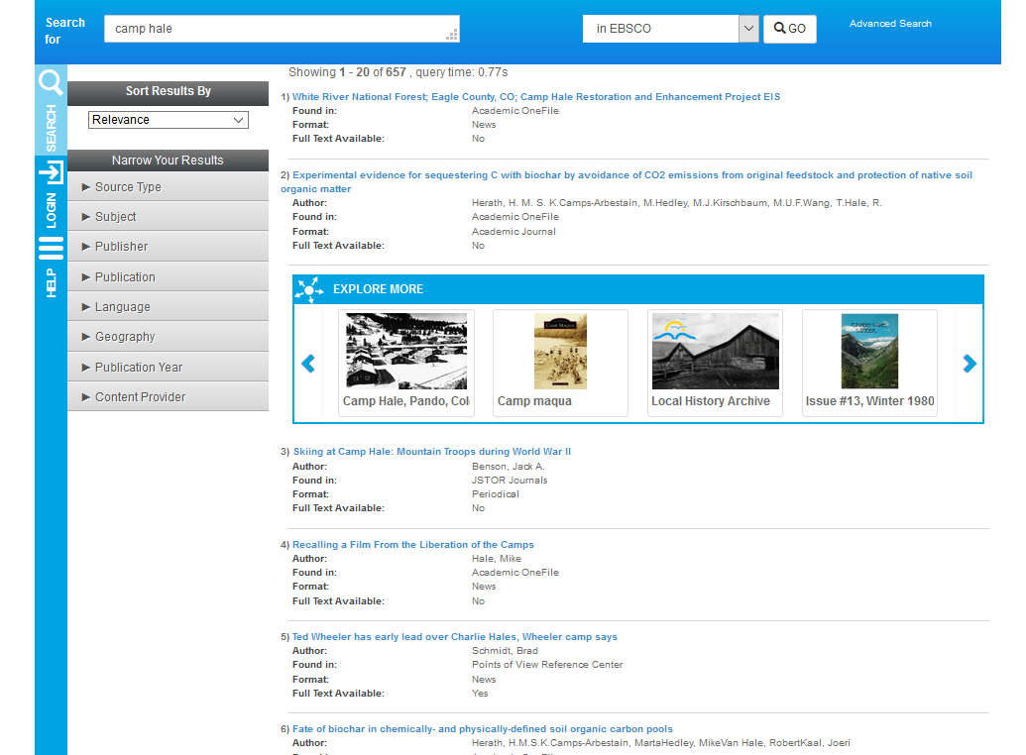

Slide 16
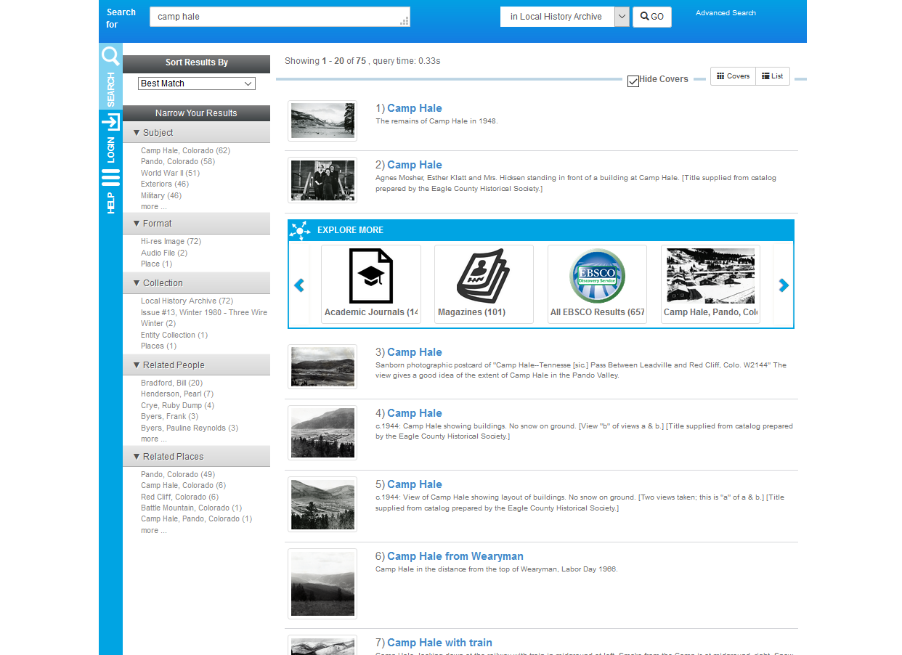

Slide 17
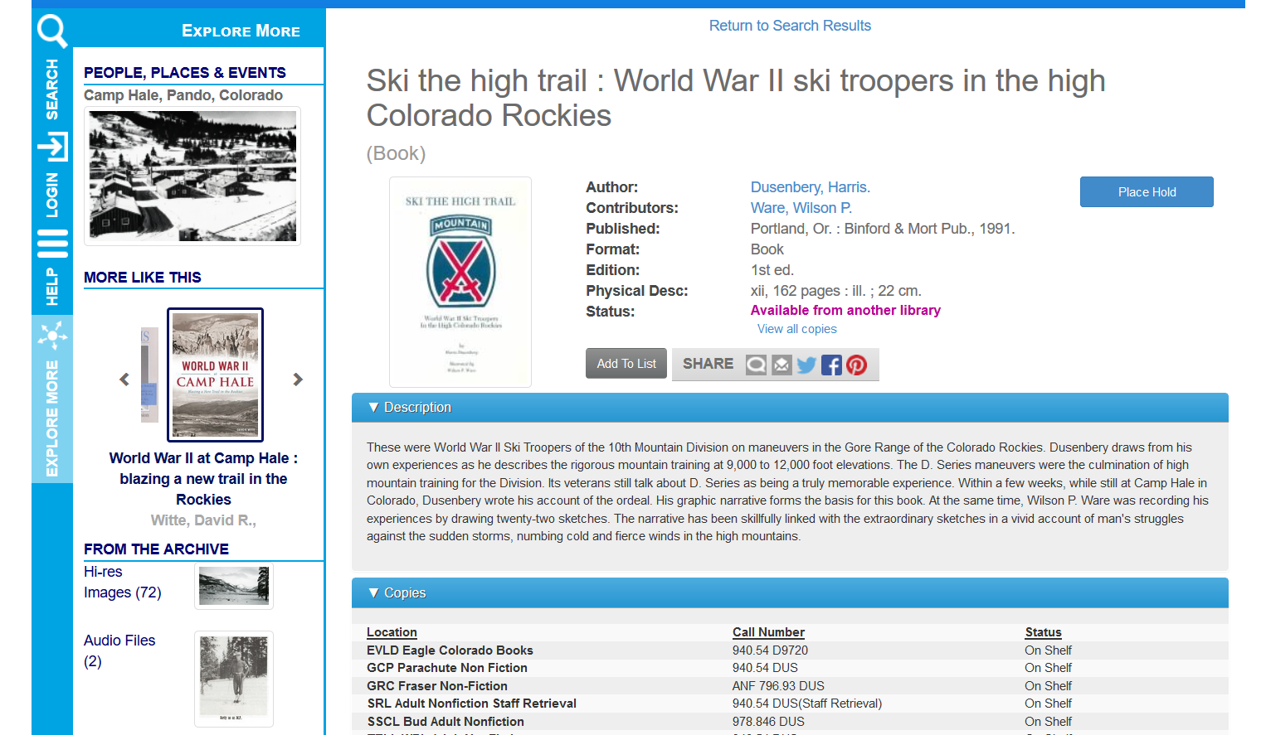

Slide 18
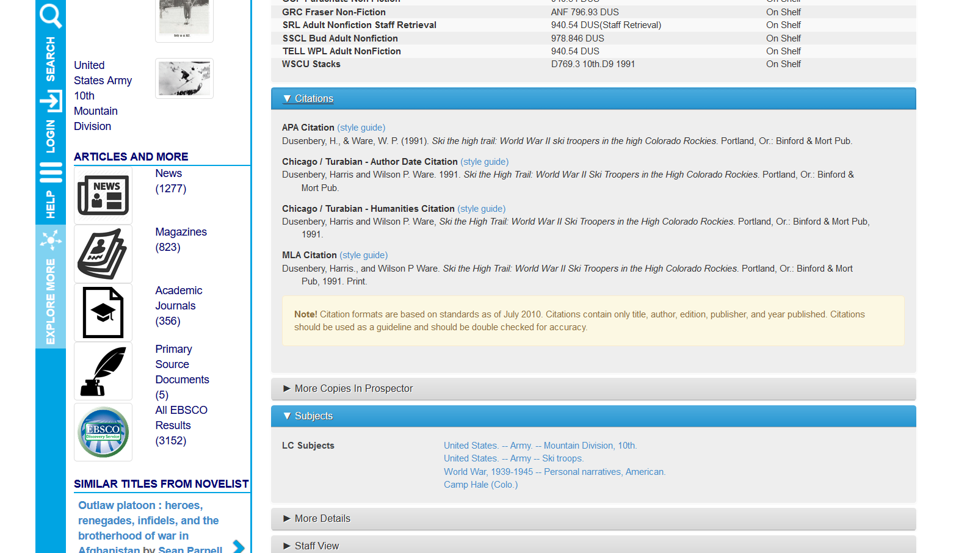

Slide 19
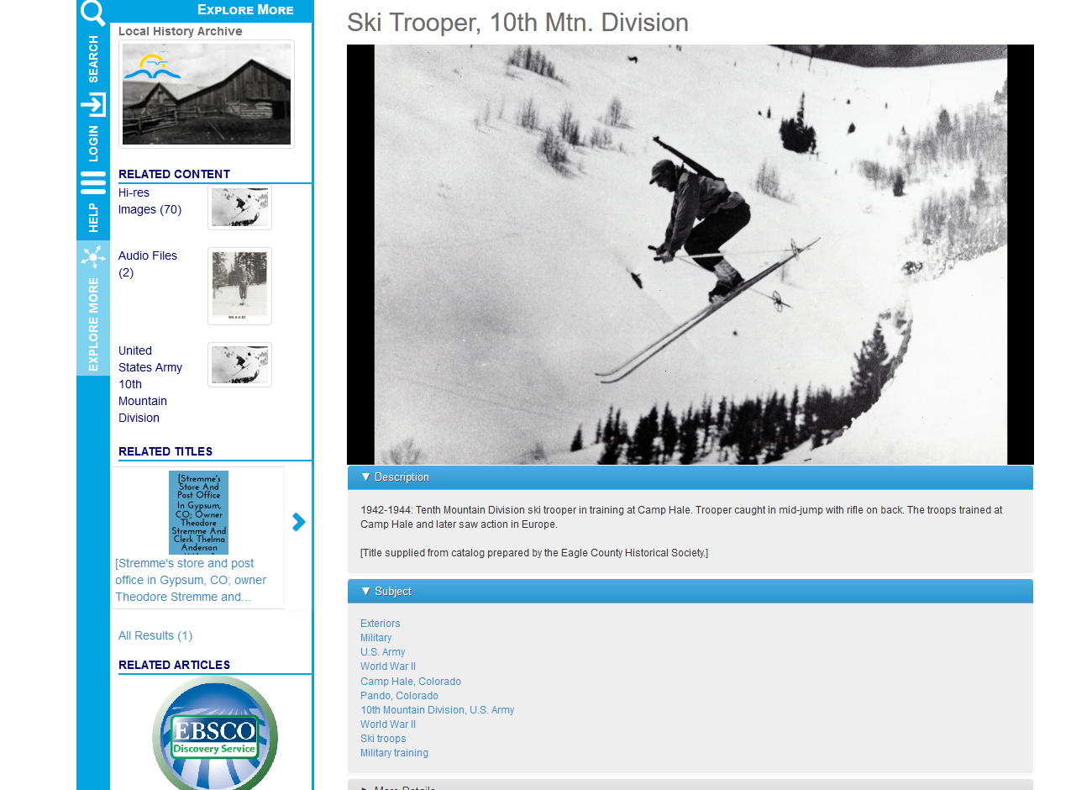

Slide 20
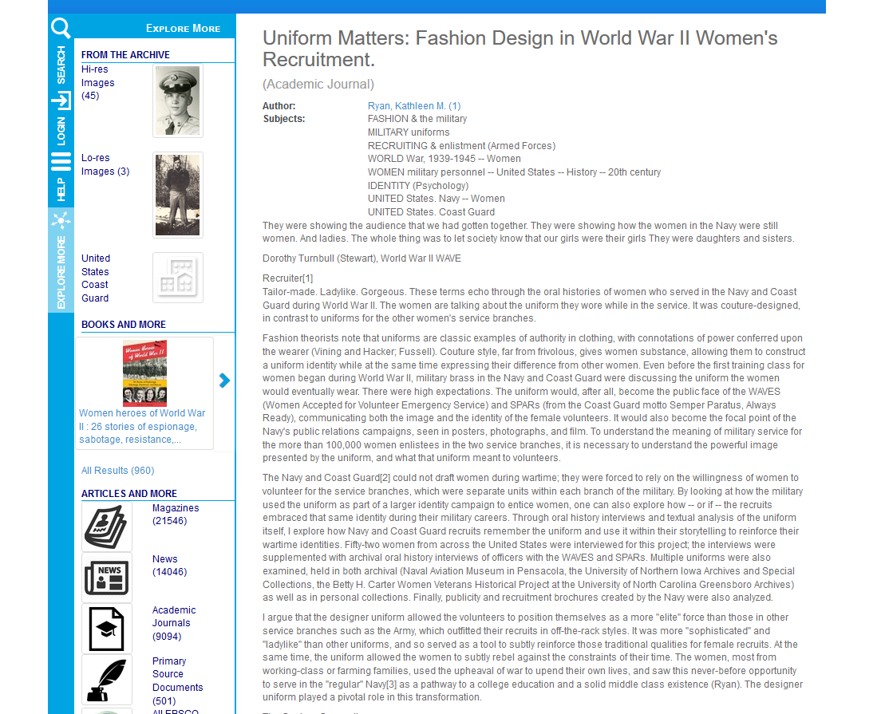

Slide 21
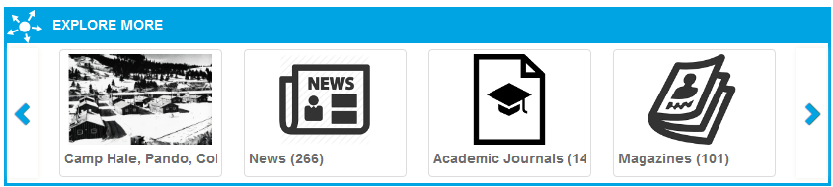
How does it all work?
Relationships in metadata based on a keyword search in Novelist
EDS Searches based on a topic

Slide 22
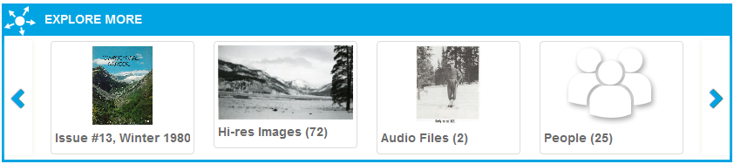
How does it work?
Solr Search of Islandora
Islandora Searches of Relationships

Slide 23
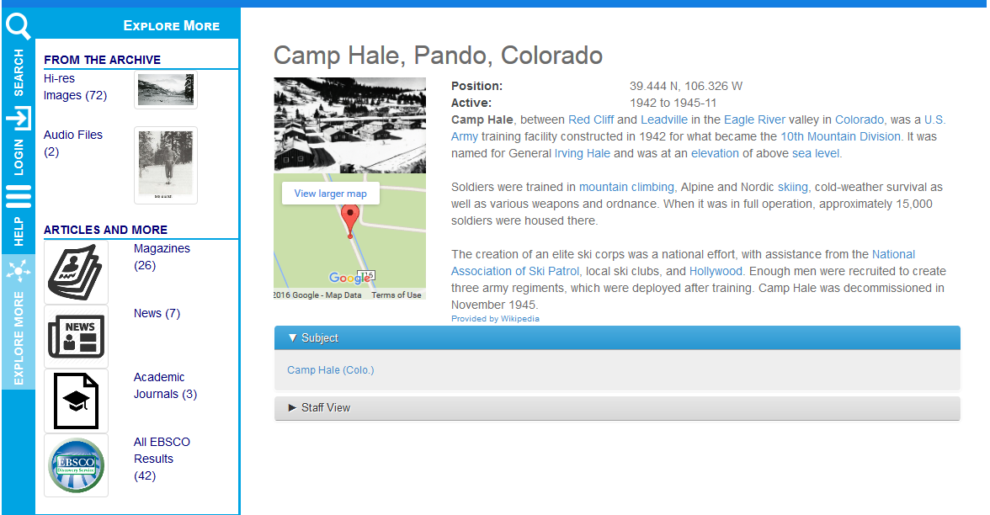
Linked Data from Who’s on First and/or geonames
Linked Data to Wikipedia
Linked Images, Oral Histories, Articles, etc from the archive will go here soon!
Related Titles based on linked data also coming soon to this sidebar

Slide 24
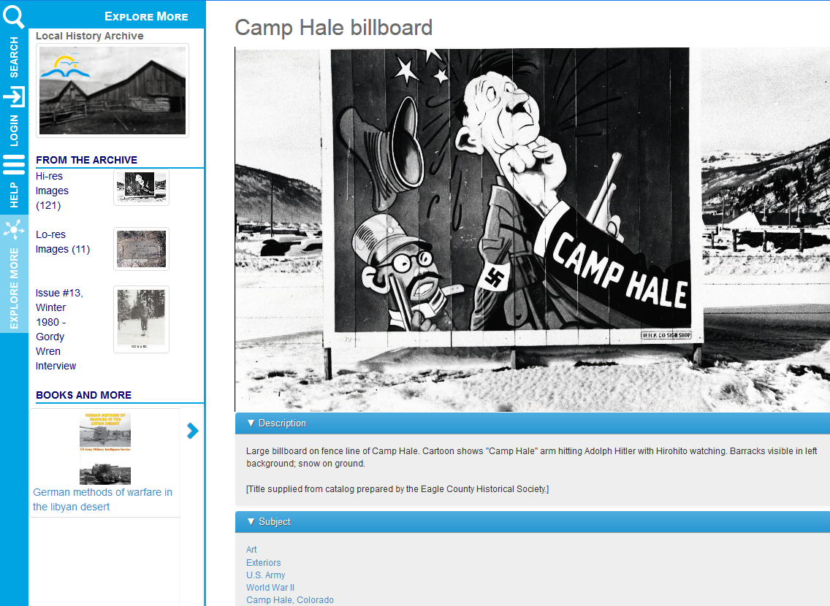
Linked Data
Smart Search and/or Linked Data

Slide 25
Linked data sources
Who’s on First
Geonames
Internal Catalog
Internal Genealogy
Internal Archive
Wikipedia
Find a Grave

Slide 26
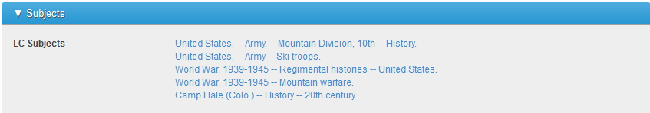
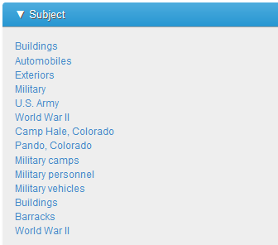
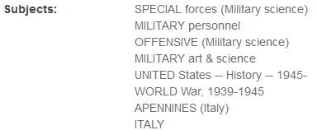
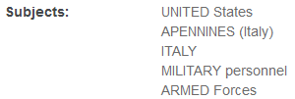
None of these things are quite like the others

Slide 27
Other challenges
Lots of new tools
Lots of new technologies
Other projects take time

Slide 28
What we’ve learned so far
When to use linked data
When to use algorithms
When to use both
Notes:
Use linked data to assert known relationships, same as, related to, etc
Use algorithms to improve the results
Use a combination to help make it easier to get to concordance with human refinement and to supplement places where we have exact matches
catalogers and archivists want to have results that that they can influence

Slide 29
What’s next
Usability, usability, usability
Performance
Subject Concordance
Islandora CLAW
Refine algorithms
More linked data entry
A few more usability studies for good measure

Slide 30
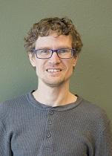
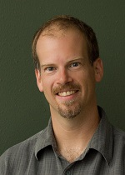
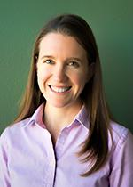
THANKS!
Marmot R&D Team
Pascal Brammeier
pascal@marmot.org
Mark Noble
mark@marmot.org
Jordan Fields
jordan@marmot.org

